Slide 1
2012 Ministry Report

Slide 2
Ministry
ERH is a 501(c) 3 tax-exempt organization.
We have a responsibility to provide “community benefit” to the communities we serve.
The Ministry Report is an annual account of how we live out that responsibility.

Slide 3

Ministry
Let’s play

Slide 4
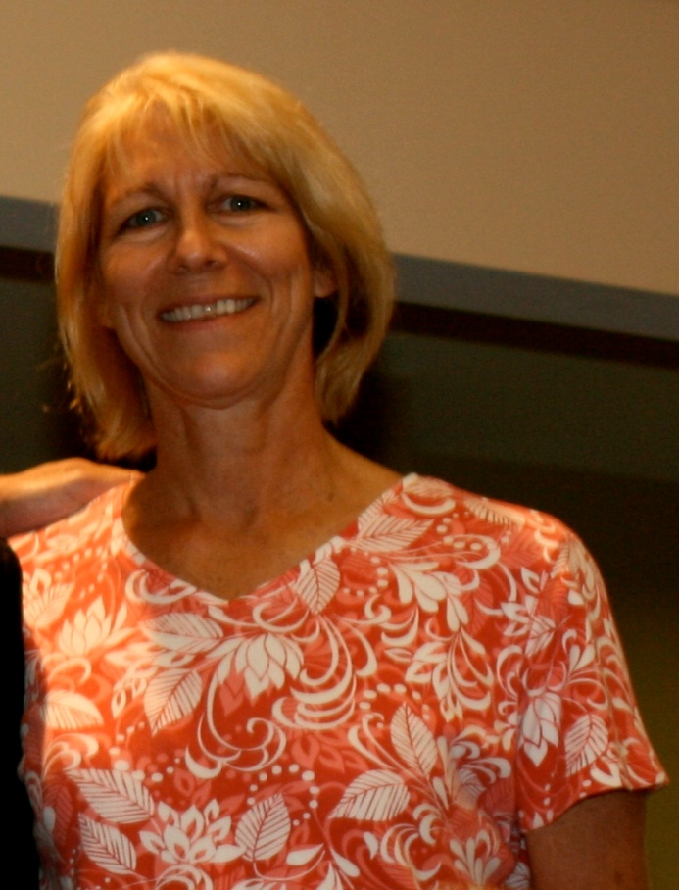
Ministry
Betty Buttermore

Slide 5
Ministry
Who makes a great pancake syrup?
Who is slated to succeed Jim Hanisian?
Who is a sociologist with aspirations of becoming a dentist?
Who once said, “Just because you are paranoid, it doesn’t mean that everyone isn’t out to get you?”

Slide 6
ministry
c) Who is a sociologist with aspirations of becoming a dentist?
(Partners in Care: $17,815)

Slide 7
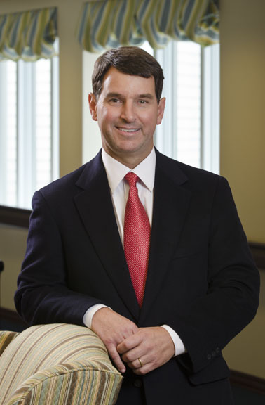
ministry
Jeff March

Slide 8
Ministry
Who once said, “Tiger Woods? Bring him on!”
What is the full name of the third month of the year?
Who wants to succeed Jim Hanisian ?
Who chairs the AL LLC Board that provided $63,194 in Ministry in 2012?

Slide 9
Ministry
d) Who chairs the AL LLC Board that provided $63,194 in Ministry in 2012?
(ERH provided transportation, spiritual services, activities, social work and wellness programs in all AL communities)

Slide 10
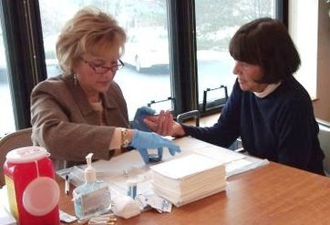
ministry
Rose Lindeman

Slide 11
ministry
Who once said, “I hope Ken Paley succeeds Jim Hanisian in Fund Development?”
Who is the song “Rambling Rose” about?
Who got a man to stop drinking 2 liters of coke a day?
Who runs Meals on Wheels?

Slide 12
ministry
c) Who got a man to stop drinking 2 liters of coke a day?
(PHM serves 80 congregations, made 31,934 contacts and was supported by ERH to the tune of $205,000 in 2012)

Slide 13
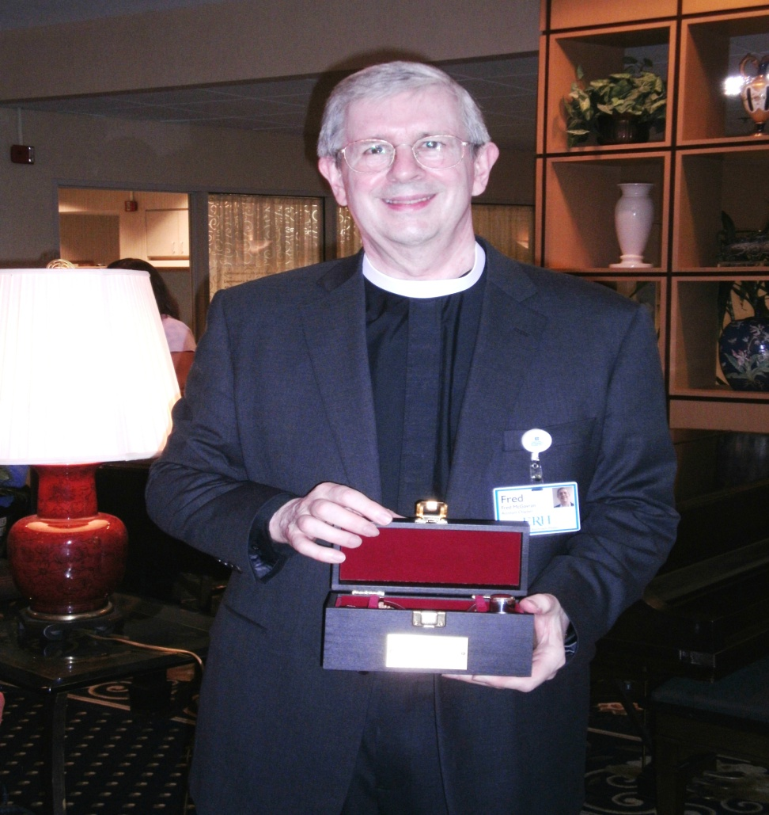
ministry
Fred McGavran

Slide 14
ministry
Who works at MPL, DH Cottages and SPV and Saint Pius Place each week?
Who once said, “Keith Lawrence is the sumo wrestler of organizational design?”
Who hopes Laura Lamb will succeed Jim Hanisian?
Who serves as head waiter at MPL?

Slide 15
ministry
a) Who works at MPL, DH Cottages and SPV and Saint Pius Place each week?
(6,185 people attended worship services and 416 Bible Studies were held in 2012)

Slide 16
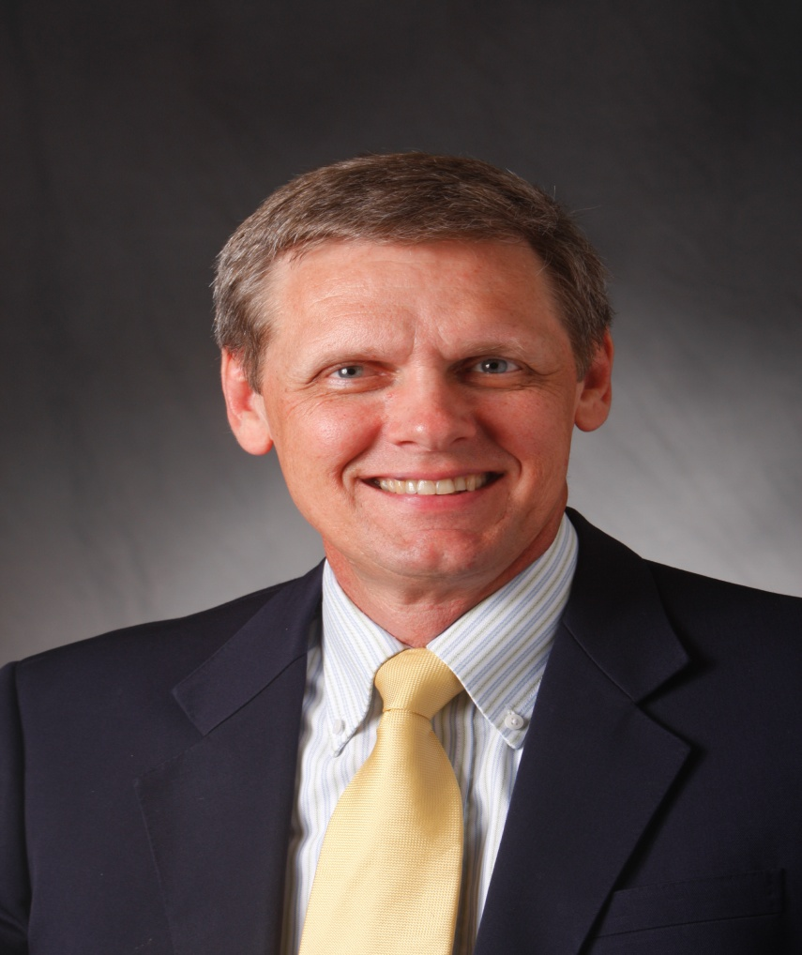
ministry
Paul Scheper

Slide 17
ministry
Who once said, “I have never inflicted an injury on myself doing DIY projects?”
Who decides how we are going to support residents who have outlived their funds?
Who thinks Jim Hanisian should succeed Jim Hanisian?
Whose brother is the mayor of Florence, KY?

Slide 18
ministry
b) Who decides how we are going to support residents who have outlived their funds?
(Last year ERH paid $1,635,000 in resident financial aid)

Slide 19
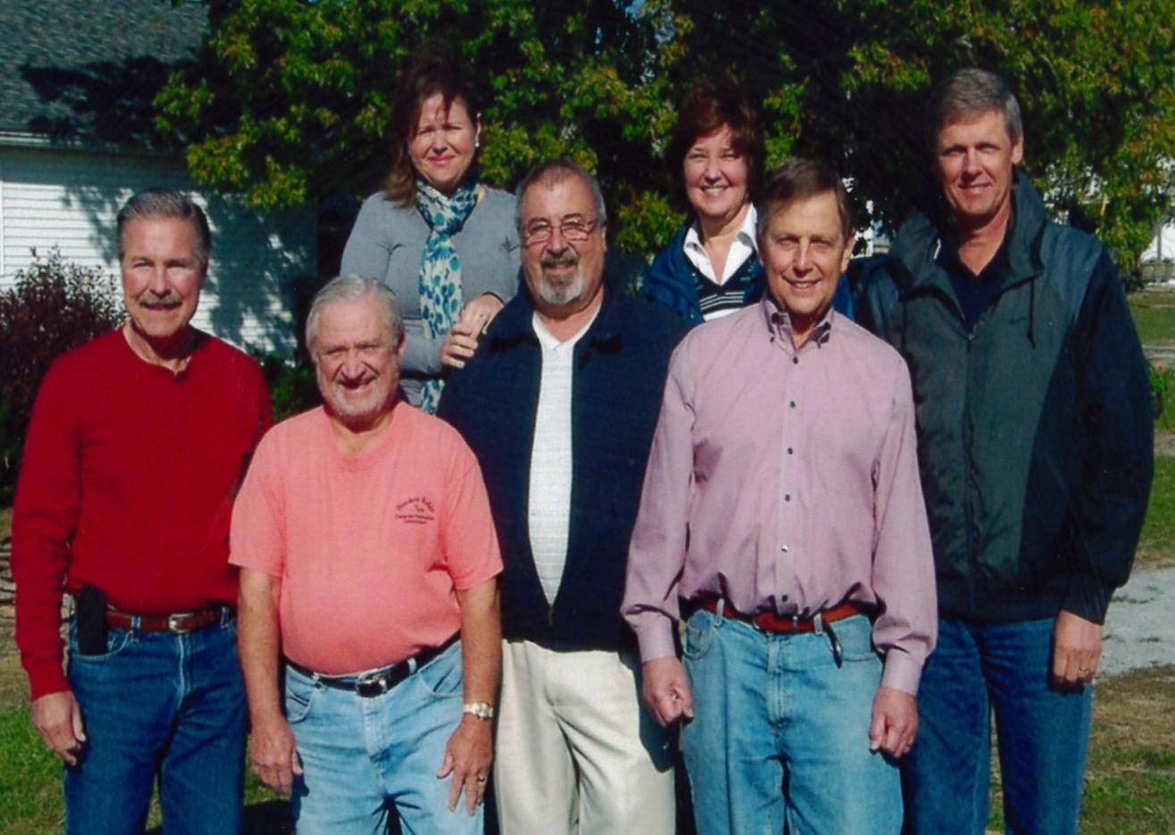
ministry
The Excel Team

Slide 20
Ministry
Which is the most competent leadership team in NFPs in the U.S.?
Who wants to “leave the campground better than they found it?”
Who is motivated by a desire to serve our Elders?
Who thinks that Jim Hanisian should raise more money?

Slide 21
ministry
Which is the most competent leadership team in NFPs in the U.S.?
Who wants to “leave the campground better than they found it?”
Who is motivated by a desire to serve our Elders?
Who thinks that Jim Hanisian should raise more money?
(In 2012, ERH spent 8.2% of its budget on ministry costs = $2,498,000)

Slide 22
ministry
ERH is proud to be accountable for its provision of community benefit.
Recent standards have cited 3% of budget as the benchmark for community benefits.
Our hope is to reach 10% by the end of the decade.

Slide 23
ministry
Questions?

